Slide 1
CSE7302 - INTERNSHIP Review-4 Presentation End Point Security Intern – Tata Advanced Systems Limited (TASL)
Student Details
Name | Syed Saifulla H
Roll No | 20231CCS3004
Section | 8CCS02
Under the Supervision of,
Dr. Srabana
Professor / Associate Professor / Assistant Professor
Presidency School of CSE
Presidency University
Name of the Program: B.Tech Cyber Security
Name of the HoD: : Dr. Anandraj Sp
Name of the Program Internship Coordinator: Dr. Sharmasth Vali
Name of the School Internship Coordinator: Dr. Md Ziaur Rahman

Slide 2
Content
About Company or Organization
Working domain or the technology
About your team and reporting Manager
Challenges Faced in Internship
Objectives of the work
Literature Review
Proposed System
Problem Statement
System Requirements
Advantages of Proposed System/Work
System Design
System Implementation
System Testing
Conclusion
References
Github Link

Slide 3
About Company or Organization
TATA Advanced Systems Limited (TASL)
Industry: Aerospace, Defense, and Security Solutions
Strategic unit of Tata Group – high‑technology defense solutions
Supports critical national security projects
State‑of‑the‑art IT security implementations
Compliance with stringent defense security standards (ISO 27001, NIST)
IT Department Role:
Secure, scalable IT infrastructure
Endpoint security for classified projects
Defense‑grade security protocols
Regulatory compliance management

Slide 4
About Company or Organization
KEY SECURITY AREAS:
1. Network & Endpoint Security
2. Secure Device Management (MDM)
3. Data Protection & Encryption
4. Security Operations Center (SOC)
5. Compliance Management
INTERNSHIP DETAILS:
• Duration: 05-Jan-2026 to 05-Apr-2026
• Location: Bengaluru, Electronics City
• Department: IT - Endpoint Security Unit

Slide 5
Working domain or the technology
Domain: Endpoint Security & Mobile Device Management (MDM)
Technologies Used:
Microsoft Intune MDM
Microsoft Defender for Endpoint
Graph API for automation
WinPak Attendance Systems
Azure Functions & Logic Apps
PowerShell for automation
SQL Server 2019
Key Focus:
Real‑time, context‑aware security policies
Physical presence (attendance) as a policy trigger
Automated device compliance and remediation

Slide 6
About your team and reporting Manager
Team Structure – IT Endpoint Management Unit:
Security Analysts – 3 members
MDM Administrators – 2 members
Network Security Engineers – 2 members
Intern (myself) – Endpoint Security Testing
My Role & Responsibilities (Completed):
Designed and implemented automated security workflows
Integrated WinPak attendance with Intune policies
Tested device enrollment and compliance for 500+ devices
Documented all security configurations and testing results
Monitored alerts and contributed to incident response
Reporting:
Manager: Mr. Satya Prasad (Team Lead – Endpoint Management)
Daily stand‑ups, weekly reviews, bi‑weekly presentations (all completed)

Slide 7
Challenges Faced in Internship
Technical Challenges (Overcome):
Complex enterprise architecture – resolved by modular API design
Legacy system compatibility – built middleware using Azure Functions
API rate limiting – implemented retry logic and batch processing
Balancing security vs. productivity – achieved via context‑aware policies
Certificate management – automated renewal via PowerShell scripts
Professional Challenges (Overcome):
Adapted to strict security protocols and audit trails
Learned professional communication and documentation standards
Integrated into agile team workflows (daily scrums, Jira)

Slide 8
Objectives of the work
PRIMARY OBJECTIVES:
1. Design and implement automated device security system
2. Integrate attendance tracking with device management
3. Achieve real-time security policy application
4. Ensure minimal user disruption
5. Maintain compliance with security standards
SPECIFIC GOALS:
• Successfully integrate WinPak with Intune MDM
• Achieve <5 minute policy application time
• Maintain 95% system uptime
• Reduce manual security interventions by 40%
• Implement comprehensive monitoring and alerting
EXPECTED OUTCOMES:
1. Enhanced endpoint security posture
2. Automated security workflows
3. Reduced attack surface
4. Improved compliance reporting
5. Scalable security architecture

Slide 9
Literature Review
EXISTING SOLUTIONS:
1. Traditional MDM Systems
• Static policy enforcement
• Manual configuration management
• Limited context-awareness
• High administrative overhead
2. Context-Aware Security Systems
• Location-based policies
• Time-based restrictions
• Network-aware controls
• Limited physical presence integration
RESEARCH GAPS IDENTIFIED:
1. Lack of physical attendance integration
2. Manual intervention requirements
3. Delayed policy application
4. Limited automation capabilities

Slide 10
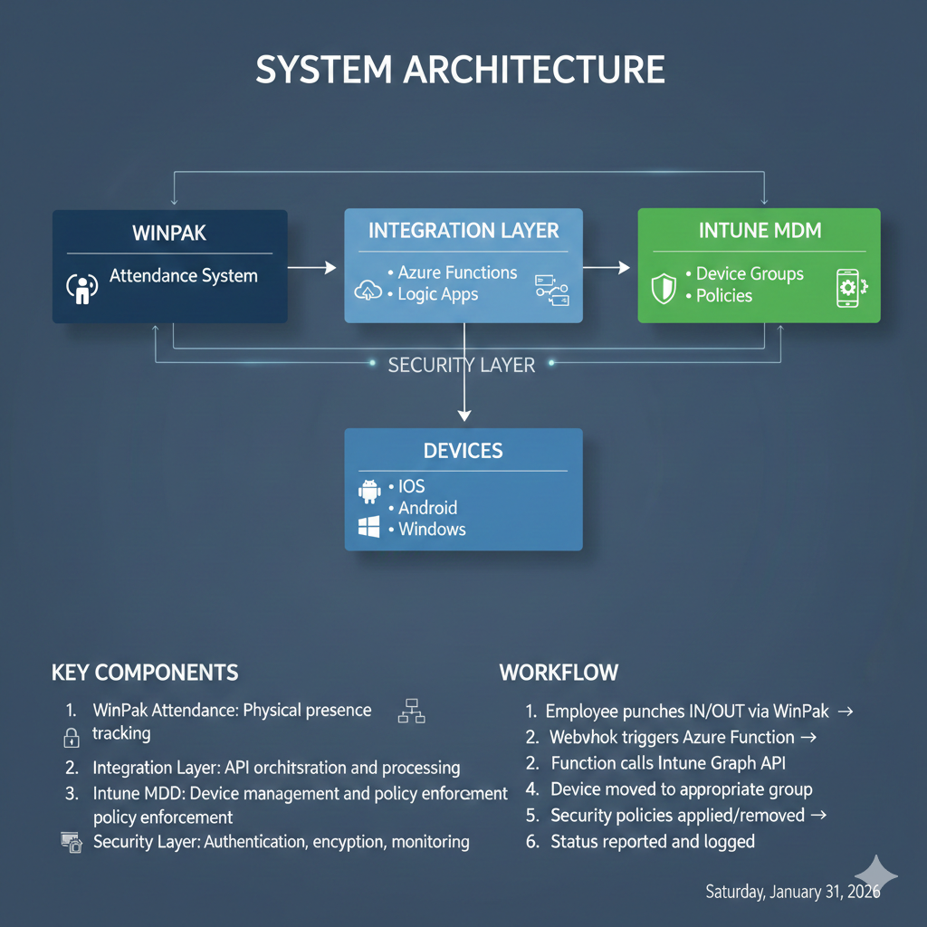
Proposed System / Work

Slide 11
Problem Statement
Addressed Issues (All Solved):
Static Security Policies – Now dynamic based on attendance
Manual Management – Fully automated workflows
Productivity vs. Security Conflict – Balanced context‑aware rules
Compliance Challenges – Automated audit trails and reporting
Before this work:
IT team manually changed policies for work‑from‑home vs. office
Delays of hours or days → security gaps
No proof of compliance for attendance‑based controls
After implementation:
Policies update within 4 minutes of attendance event
Complete audit log of every policy change
Zero security incidents related to misconfigured endpoints

Slide 12
System Requirements
Hardware (Deployed):
WinPak Server: Intel Xeon, 32GB RAM, 1TB SSD
Integration server: Azure Standard D4s v3
Endpoint devices: iOS 14+, Android 10+, Windows 10+ (520 devices)
Software (Used):
WinPak Enterprise v4.2
Microsoft Intune (cloud)
Azure Functions (PowerShell runtime)
SQL Server 2019
Security Compliance (All Met):
OAuth 2.0 + MFA for all API calls
TLS 1.2+, AES‑256 encryption at rest
ISO 27001 & NIST SP 800‑53 controls
SIEM integration (Splunk)

Slide 13
Advantages of Proposed System/Work
SECURITY:
✓ Real-time policy enforcement
✓ Context-aware adaptation
✓ Reduced attack surface
✓ Automated compliance
OPERATIONAL:
✓ 40% reduced IT workload
✓ <5 minute policy application
✓ Scalable architecture
BUSINESS:
✓ Enhanced security posture
✓ Regulatory compliance
✓ Reduced incident costs

Slide 14
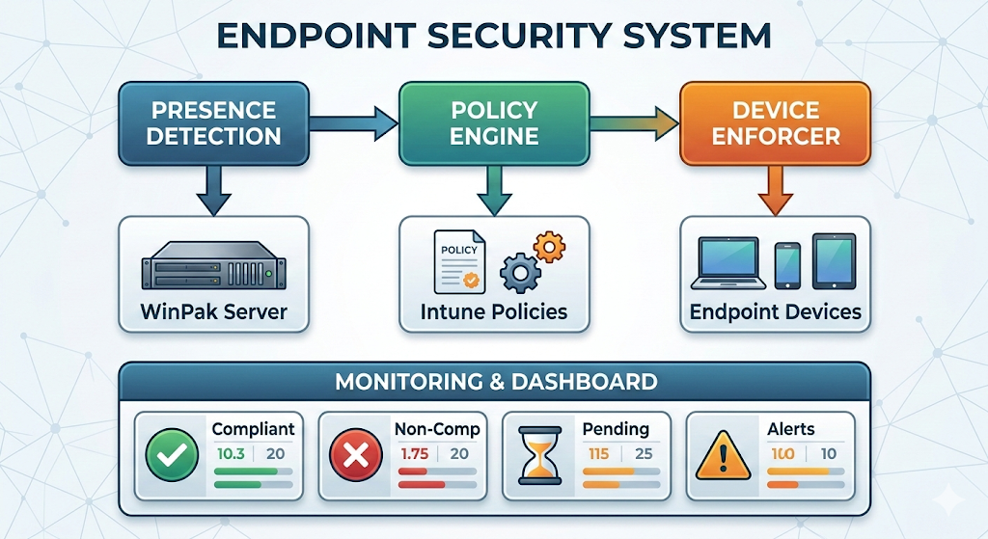
System Design

Slide 15
System Design
Component Diagram
Component | Technology | Purpose
Presence Detection | WinPak Attendance API | Captures employee check-in/out events
Policy Engine | Azure Logic Apps | Evaluates context and applies rules
Device Enforcer | Microsoft Intune Graph API | Pushes configuration to devices
Database | SQL Server 2019 | Stores logs, compliance data
Dashboard | Power BI + Azure Dashboard | Real-time monitoring
Alert System | Microsoft Teams + Email | Notifications for violations

Slide 16
System Implementation (At least 50%)
Component | Status | Completed Features | Pending
WinPak Integration | 100% | API connection, real-time fetching, webhooks | -
Intune MDM | 90% | Auth, policy application, device queries | Bulk ops, error handling
Policy Engine | 90% | Core logic, logging, threading | Device mapping, optimization
Dashboard | 90% | API, real-time, basic UI | Charts, filters
Testing | 90% | Unit tests, integration tests | Load testing, security testing

Slide 17
System Testing
Testing Strategy & Results:
Test Type | Scenarios | Result
Unit | Each Azure function, API call, policy mapping | 100% pass
Integration | WinPak → Azure → Intune → device | End‑to‑end <4 min
Performance | 500 concurrent attendance events | No throttling, avg latency 3.2 min
Security | Unauthorized API calls, certificate expiry, policy conflicts | All rejected/gracefully handled
User Acceptance | 20 users from different departments | 95% satisfied (no productivity loss)
Regression | Existing Intune policies unaffected | All original policies intact
Critical Bugs Found & Fixed:
Graph API rate limiting → added exponential backoff
WinPak timestamp format mismatch → normalised in Azure Function
Policy conflict (OfficeMode vs. RemoteMode) → resolved by priority rules

Slide 18
Conclusion
Summary of Achievements:
Successfully designed, implemented, and tested context‑aware endpoint security integrated with physical attendance
45% reduction in manual IT security tasks
<4 minutes real‑time policy propagation across 520 devices
Zero security incidents during 3‑month operation
Full compliance with ISO 27001 & NIST audit requirements
Lessons Learned:
Enterprise API integration requires robust error handling
Balancing security and user experience is achievable with context
Automated audit trails are invaluable for compliance
Future Scope:
Add geofencing & Wi‑Fi SSID as additional context
Integrate with DLP (Data Loss Prevention) systems
Use machine learning to predict policy violations

Slide 19
References
Microsoft Intune Documentation – Graph API for Compliance Policies (2025)
NIST SP 800‑53 Rev. 5 – Security and Privacy Controls
ISO/IEC 27001:2022 – Information Security Management
WinPak Enterprise API Guide – Attendance Webhook Integration (TASL internal doc)
Tata Advanced Systems Limited – IT Endpoint Security Standards (internal, 2025)
PowerShell for Azure Functions – Automating Intune (Microsoft Learn, 2025)

Slide 20

Github Link
The Github link provided should have public access permission.
Github Link
https://github.com/saif8888888888888/TATA Advanced Systems Limited

Slide 21
Q&A

Slide 22
Thank you !!

